Slide 1
Programming 101 Day 5
Basic Algorithm & HTML Manipulation

Slide 2
Outline
Searching & string
Sorting

Slide 3
Searching & String

Slide 4
Searching
Problem: Find the index of word ‘Mars’ in the paragraph!
Paragraph :
The scientists measured seasonal changes in gases that fill the air directly above the surface of Gale Crater on Mars, where Curiosity landed. They have published their findings in the journal JGR-Planets.

Slide 5
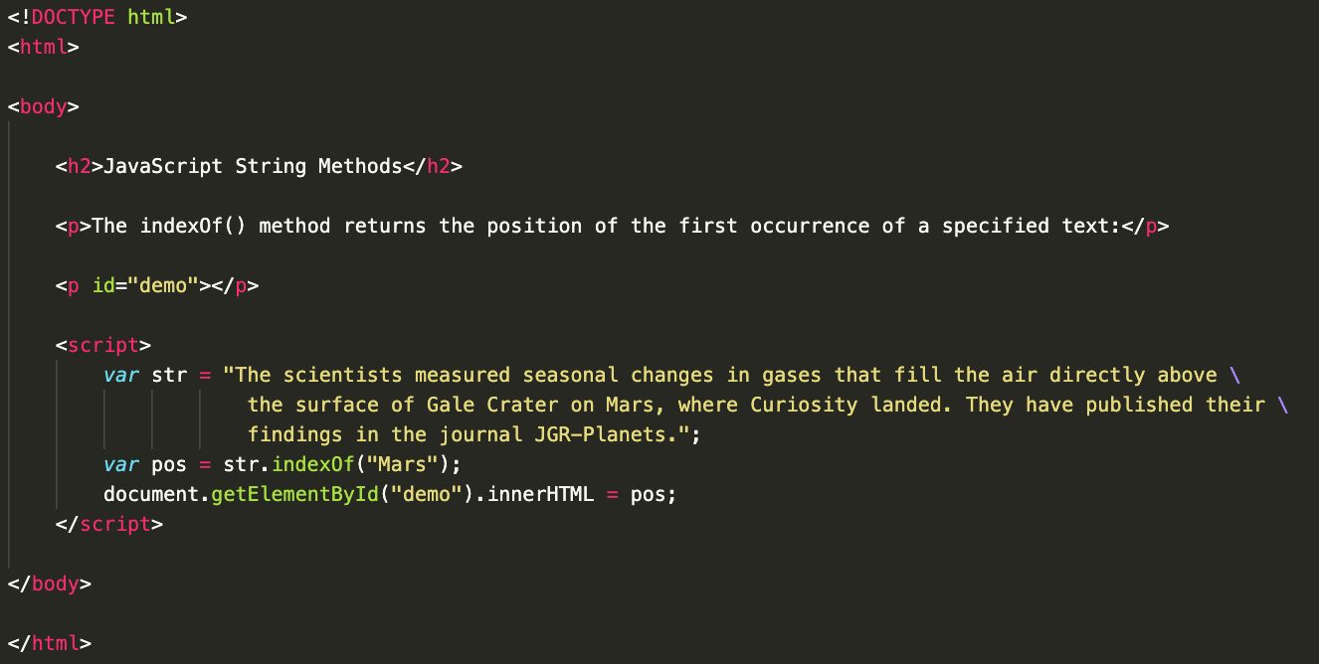
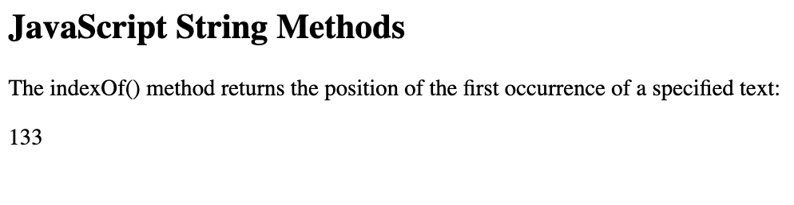
Search with String Method

Slide 6
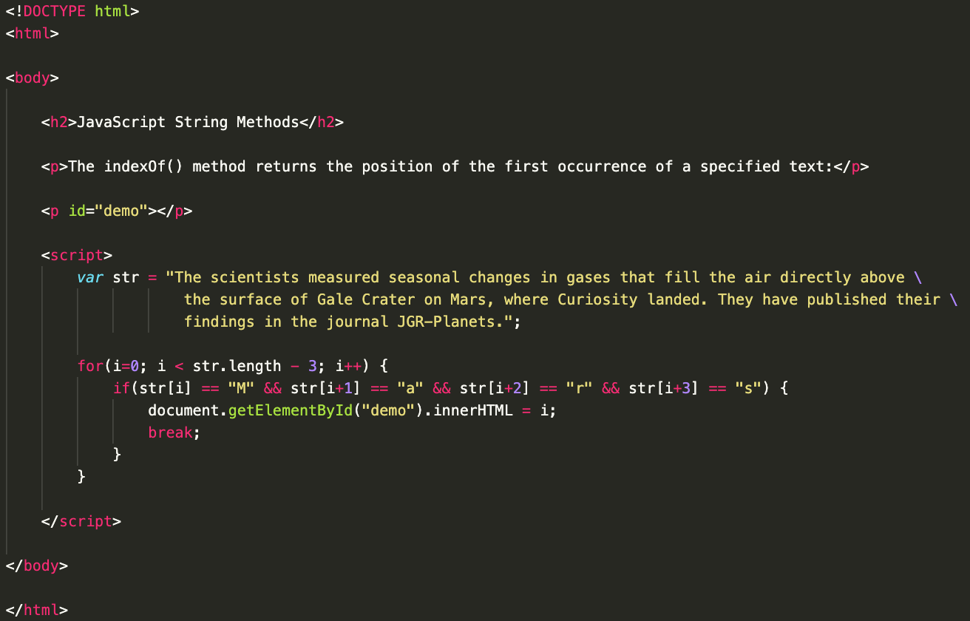
Search with loop

Slide 7
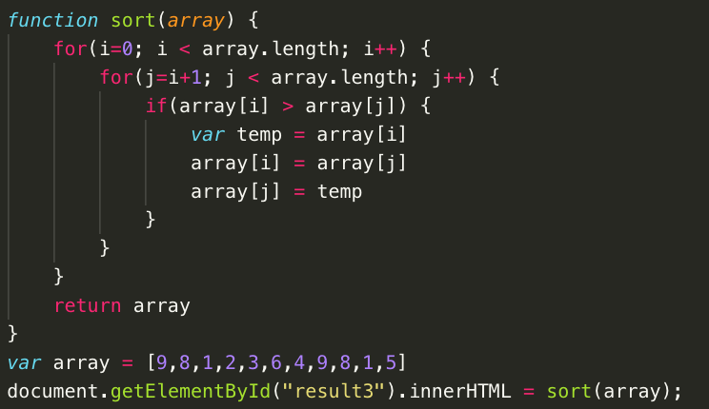
Sorting

Slide 8
Keep Practicing
Find smallest and second smallest elements in an array [4,7,9,3,5,7,9,2,6,3,5,2,4]
Sort array [4,7,9,3,5,7,9,2,6,3,5,2,4] in descending order

Slide 9
“Tell me and I forget. Teach me and I remember. Involve me and I learn.”
- Benjamin Franklin

